Slide 1

Communication Skills for Engineers
Dr. Priyanka Tripathi
Dr. Sweta Sinha
Department of HSS
IIT Patna

Slide 2

Most of the time, Communication gets confused with Conversation. In fact, the two are distinctly different. A conversation full of pleasantries is most often devoid of any useful information, whereas communication is meant only for an exchange of information. It is very important to realize that communication is a two way affair which aims at passing on or receiving a specific piece of information.

Slide 3

Derived from a Latin word, ‘communicare’ which indicates ‘sharing’ or ‘exchanging’ the information
Communication refers to transmission of facts, figures and ideas in an organized manner

Slide 4

Keith (1993) defines communication as "the transfer of information and understanding from one person to another person. It is a way of reaching others with facts, ideas, thoughts and values. It is a bridge of meaning among people so that they can share what they feel and know. By using this bridge a person can cross safely the river of misunderstanding that sometimes separates people"

Slide 5
Miller (1951) puts it this way:
"communication takes place when there is information at one place or person, and we want to get it to another place or person"

Slide 6
Verdman (1970) describes a design for effective communication and says, "effective communication is purposive symbolic interchange resulting in workable understanding and agreement between the sender and the receiver"

Slide 7

7% of meaning is in the words that are spoken
38% of meaning is paralinguistic
55% of meaning is conveyed through facial expression

Slide 8

Social
Collective
Extrovert
Dynamic
Multidimensional
Impression
Expression

Slide 9

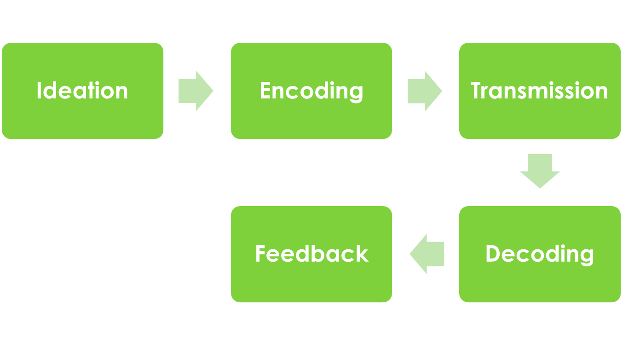
Stage 1
Stage 2
Stage 3
Stage 5
Stage 4

Slide 10

Information
Advice
Order
Suggestion
Persuasion
Education
Warning
Motivation

Slide 11

Internal and External
Verbal and Non Verbal
Formal and Informal
Technical and General
Interpersonal and Intrapersonal
Upward, Downward, Diagonal and Horizontal Communication

Slide 12

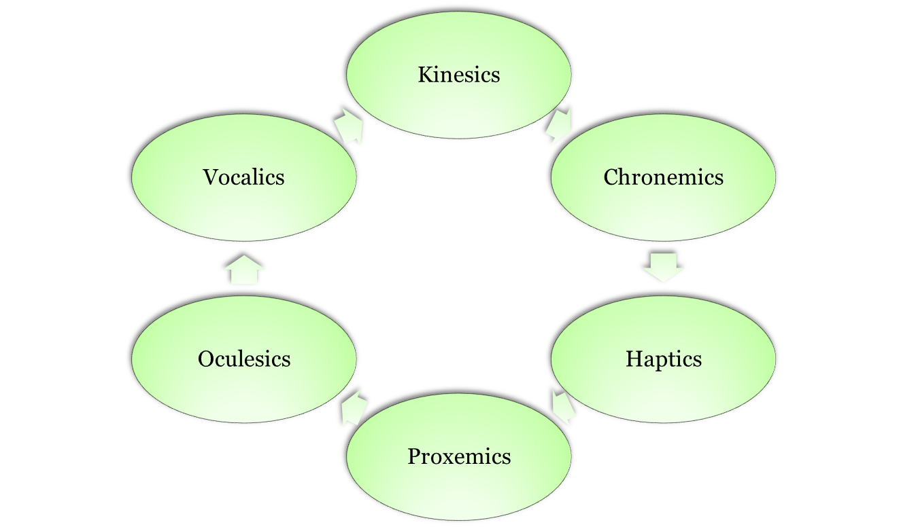

Slide 13
Kinesics:
The word kinesics comes from the root word kinesis, which means “movement,” and refers to the study of hand, arm, body, and face movements. Specifically, this section will outline the use of gestures, head movements and posture, eye contact, and facial expressions as nonverbal communication.

Slide 14
Chronemics refers to the study of how time affects communication. Time can be classified into several different categories, including biological, personal, physical, and cultural time.
When?
How Long?

Slide 15
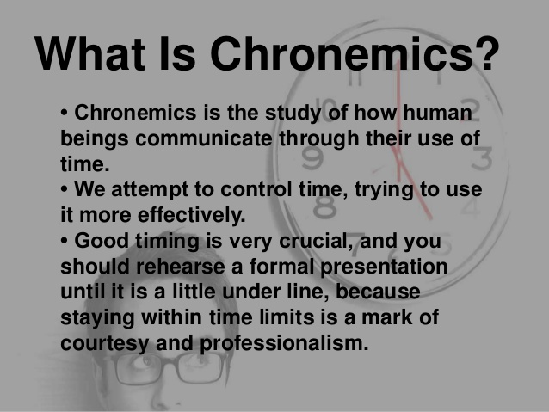

Slide 16
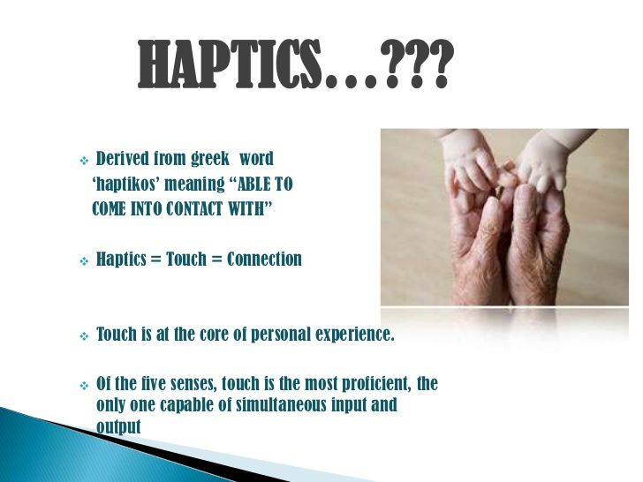
Haptics is the study of touch in nonverbal communication.

Slide 17

Power Shake
To avoid the power shake step in with left foot when you see the power shake coming. This will invade the other person’s space and put them off kilter.
Board Room Shake
This person shakes hands strongly and grips the forearm with the other hand. Usually it is a managing director who wants to show control.
Bone Crusher Shake
While this grip may be okay between two alpha males, in most circumstances it is too hard and holds for too long.
Wet Fish Shake
This is known as the limp lettuce handshake. If you’re on the receiving end, take control by adjusting this handshake and giving two firm shakes.

Slide 18
Confident Shake
This is described as a firm hold with two shakes and eye contact.
Empathetic Shake
This type of handshake involves a brush of the forearm with the left hand for no longer than three to four seconds. Those who use this type of handshake will have an 80 per cent chance of getting on well with the other person. Be warned though – touching for longer than five seconds invades the other person’s personal space.
Patronising Shake
Do not grab hold of the other person’s wrist when shaking hands.

Slide 19
Proxemics refers to the study of how space and distance influence communication. We only need look at the ways in which space shows up in common metaphors to see that space, communication, and relationships are closely related.
For example, when we are content with and attracted to someone, we say we are “close” to him or her. When we lose connection with someone, we may say he or she is “distant.” In general, space influences how people communicate and behave.

Slide 20
Oculesics:
We also communicate through eye behaviors, primarily eye contact. While eye behaviors are often studied under the category of kinesics, they have their own branch of nonverbal studies called oculesics, which comes from the Latin word oculus, meaning “eye.” The face and eyes are the main point of focus during communication, and along with our ears our eyes take in most of the communicative information around us. The saying “The eyes are the window to the soul” is actually accurate in terms of where people typically think others are “located,” which is right behind the eyes.

Slide 21
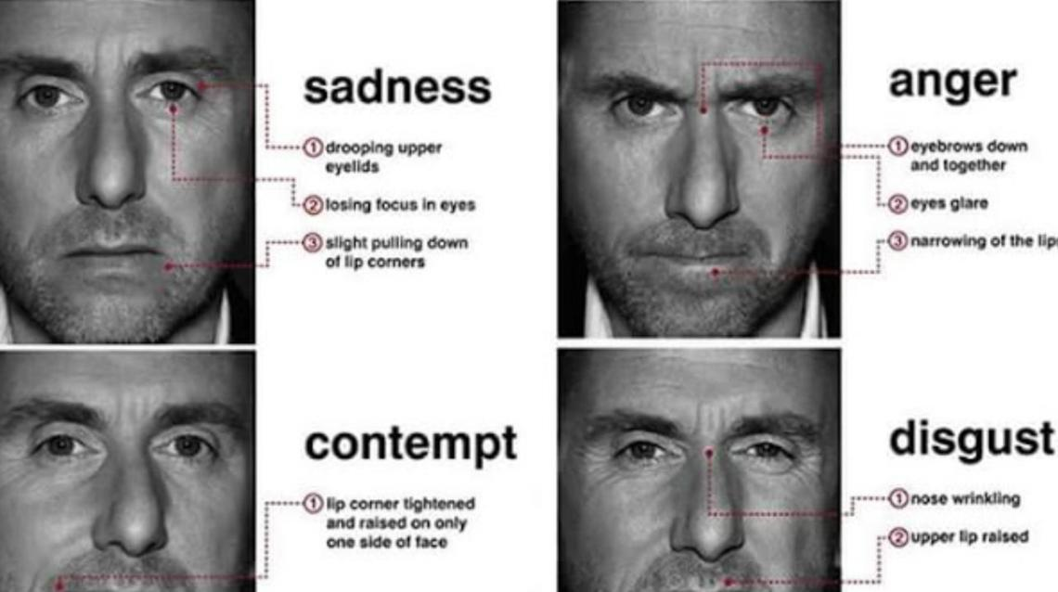

Slide 22
We learned earlier that paralanguage refers to the vocalized but nonverbal parts of a message. Vocalics is the study of paralanguage, which includes the vocal qualities that go along with verbal messages, such as pitch, volume, rate, vocal quality, and verbal fillers.

Slide 23

The Informal Communication is the casual and unofficial form of communication wherein the information is exchanged spontaneously between two or more persons without conforming the prescribed official rules, processes, system, formalities and chain of command.

Slide 24
The informal communications are based on the personal or informal relations such as friends, peers, family, club members, etc. and thus is free from the organizational conventional rules and other formalities. In the business context, the informal communication is called as a “grapevine” as it is difficult to define the beginning and end of the communication.
Grapevine is a form of informal communication, operates both in internal and external informal channels which can contribute to and benefit the organization.

Slide 25

Upward
Downward
Horizontal
Diagonal
Grapevine

Slide 26

To achieve success
To sustain the tempo of growth
For internal and external communication
To bridge the multicultural gap
To create harmony

Slide 27

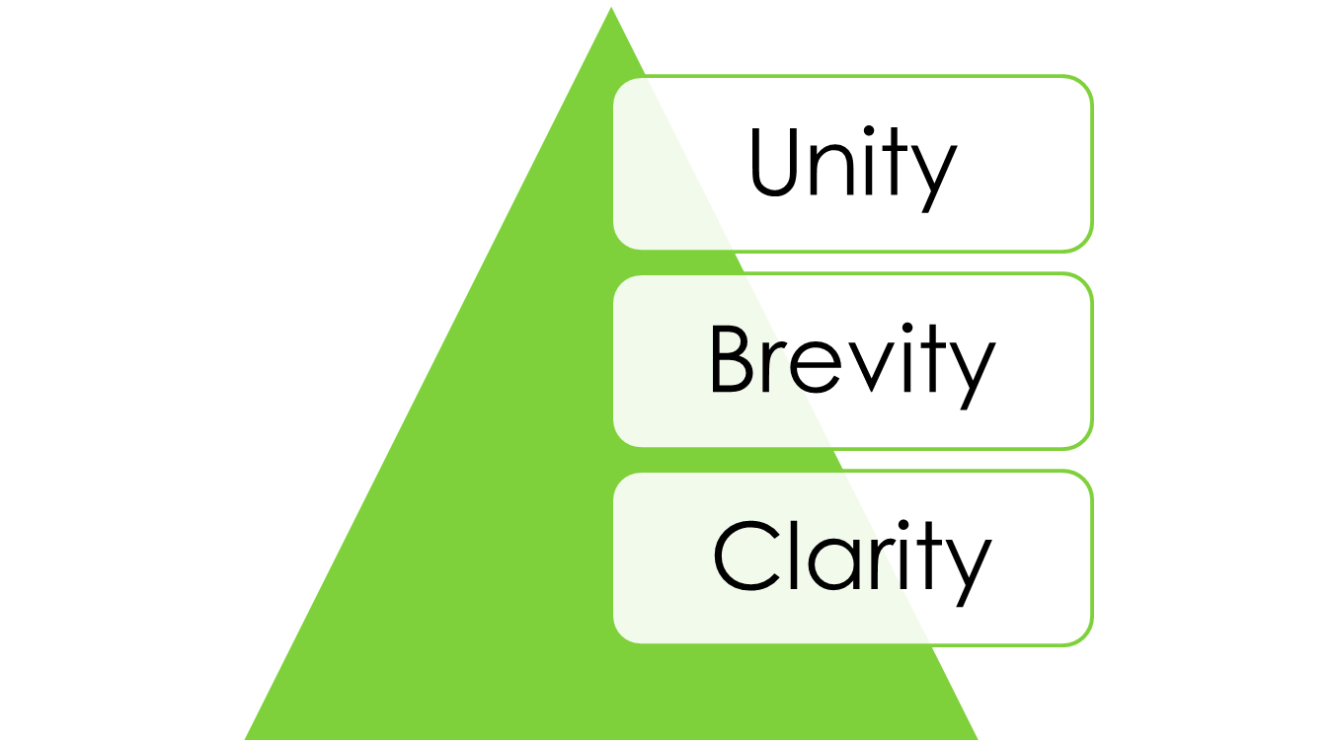

Slide 28

Check facts for accuracy of information
Revise your draft for synthesis and syntax
Avoid difficult and unfamiliar words
Avoid excessive and complex jargons
Look for a logical sequencing

Slide 29

Avoid repetition
Avoid wordiness
Do not include unnecessary details
Revise your documents thoroughly in order to make it concise
Avoid exaggeration

Slide 30

Do not use indirect expressions
Use direct sentences
Use specific words and phrases
Avoid artificial eloquence and ornamentation
Simplicity

Slide 31

The process of communication has multiple barriers. The intended communication will often be disturbed and distorted leading to a condition of misunderstanding and failure of communication. The Barriers to effective communication could be of many types like linguistic, psychological, emotional, physical, and cultural etc. We will see all of these types in detail below.

Slide 32
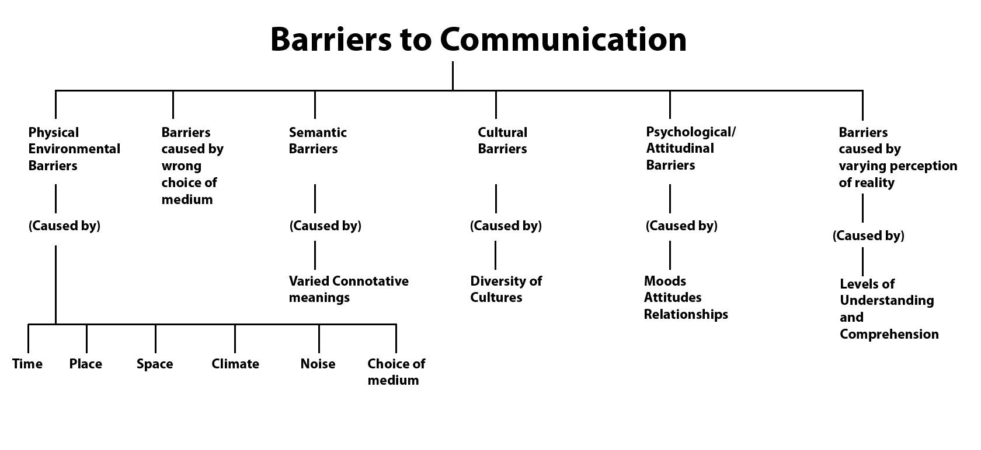

Slide 33
Physical Barriers to Communication:
They are the most obvious barriers to effective communication. These barriers are mostly easily removable in principle at least. They include barriers like noise, closed doors, faulty equipment used for communication, closed cabins, etc. Sometimes, in a large office, the physical separation between various employees combined with faulty equipment may result in severe barriers to effective communication.

Slide 34
Physiological Barriers:
Certain disorders or diseases or other limitations could also prevent effective communication between the various channels of an organization. The stammering, shrillness of voice, dyslexia, being tone deaf etc. are some examples of physiological barriers to effective communication. However, these are not crucial because they can easily be compensated and removed.
Technological Barriers:
Other barriers include the technological barriers. The technology is developing fast and as a result, it becomes difficult to keep up with the newest developments. Hence sometimes the technological advance may become a barrier. In addition to this, the cost of technology is sometimes very high.

Slide 35
Linguistic Barriers:
The language barrier is one of the main barriers that limit effective communication. Language is the most commonly employed tool of communication. The fact that each major region has its own language is one of the Barriers to effective communication. Sometimes even a thick dialect may render the communication ineffective.

Slide 36
Interpersonal Barriers:
Interpersonal barriers are what ultimately keep us from reaching out to each other and opening ourselves up, not just to be heard, but to hear others. Oddly enough, this can be the most difficult area to change. Some people spend their entire lives attempting to overcome a poor self-image or a series of deeply rooted prejudices about their place in the world. They are unable to form genuine connections with people because they have too many false perceptions blocking the way.

Slide 37
Psychological Barriers:
There are various mental and psychological issues that may be barriers to effective communication. Some people have stage fear, speech disorders, phobia, depression etc. All of these conditions are very difficult to manage sometimes and will most certainly limit the ease of communication.

Slide 38
Perceptual (Pre-conceived notions/Prejudices) barriers:
Differing opinions and views can reduce objectivity. You may enter a conversation assuming that the listener will not understand you or be uninterested in what you're speaking about - this may consequently lead you to unintentionally harming your message, such as, using dismissive language or trying to be more humorous.
Or you may be the listener that doesn't agree with the speaker's beliefs so you choose not to listen properly or you look for faults in what they're saying rather than trying to understand.

Slide 39
Cultural barriers:
Cultural barriers can interfere with communication in a variety of ways:
The norms of communication vary between cultures, such as, personal space. It's important to find common ground in these situations.
2. People may form assumptions based on stereotypes of the other person's culture (cultural noise).
3. Work cultures differ between companies which means you have to adapt to your company's culture to communicate effectively.

Slide 40
Organizational structure barriers:
Companies with unclear structures can make communication difficult. For example, they may have an inefficient information sharing and communication system, employees may not know what their role is in the communication system etc.
If a company has a complex structure with lots of management levels, information will be lost or distorted as it travels through each layer of the hierarchy.

Slide 41
Emotional barriers:
Emotional reactions from either or both the speaker and listener can prevent effective communication. It's difficult to put aside and not act on our emotions but it's necessary. Try to work out what words, topics etc. can trigger your strong emotional reactions so you can create a plan for managing them.
A common emotion, in regard to communication, is fear. People often have the tendency to think that their opinions don't matter in the workplace or that people will negatively judge them if they speak up. But this isn't the case and it's likely that others around you will also feel too afraid to say anything so they'll respect you when you do speak up. What is valuable to you will be valuable to another person.

Slide 42
Attitude Barriers:
Certain people like to be left alone. They are the introverts or just people who are not very social. Others like to be social or sometimes extra clingy! Both these cases could become a barrier to communication. Some people have attitude issues, like huge ego and inconsiderate behaviours.

Slide 43
Gender Barriers:
Gender barriers have become less of an issue in recent years, but there is still the possibility for a man to misconstrue the words of a woman, or vice versa.
Even in a workplace where women and men share equal stature, knowledge and experience, differing communication styles may prevent them from working together effectively. Gender barriers can be inherent or may be related to gender stereotypes and the ways in which men and women are taught to behave as children.
Although not all men or all women communicate the same way as the rest of their gender, several traits that tend to be more common in one gender or the other have been identified. Understanding these tendencies is key in creating a work environment that fosters open communication among all employees.

Slide 44

Roadblocks to Communication are:
Differences in Perspective
Differences in Knowledge Levels
Lack of Common Language
Stereotyping and Concluding in haste
Strong Emotions
Self-centeredness
Laziness

Slide 45
Roadblock 1: Differences in Perspective
Factors contributing:
Socio-cultural status, interpersonal experiences, temperament, personality, values, position in life, political & religious beliefs and so on

Slide 46
Roadblock 2: Differences in Knowledge Levels
Professionals and amateurs having difference in knowledge levels within an organisation may have difficulty in communication

Slide 47
Roadblock 3: Lack of Common Language
Language of computer/law, specific language
Jargon, slang word, acronyms and short forms

Slide 48
Roadblock 4: Stereotyping and Concluding in haste
Tendency to stereotype and jump to conclusions

Slide 49
Roadblock 5: Strong Emotions
Love is blind
So is hate
So is anger
So is jealousy

Slide 50
Roadblock 6: Self-centeredness
we all are egocentric.
We cannot see beyond our nose. Varying degree of self-centeredness can seriously weaken our role as communicators and communicatees.

Slide 51
Roadblock 7: Laziness
To be a communicator is a hard work. To be a good communicator is a very hard work.

Slide 52
Towards Redemption
Get to know the people we communicate with
Learn to look at things from other’s perspective
Seek and offer feedback
Choose the right medium, the right channel
Talk less, listen more
Mind your tone
Plan the communication carefully, especially the difficult one

Slide 53

Lectures
Tutorials and practical
Seminars and workshops
Technical presentations
Academic discussions
Viva voce

Slide 54

Hearing: involuntary, happens automatically, passive process, the listener plays a passive part, one – way process
Listening: voluntary, requires conscious effort, active process, the listener plays a very active part, two- way process

Slide 55

Superficial: little awareness of the content, output is zero, ignoring the message, lack of concentration.
Appreciative: main purpose is to get enjoyment and pleasure, entertainment. Eg: listening to songs, jokes, stand up comedy
Focused: listening for specific purpose, motivates decision making. Eg: listening to news or sports commentary

Slide 56
Evaluative: evaluation of oral message and developing a line of thought, both explicit and implicit meanings are important here, making mental notes. Eg: classroom lectures, workshops, seminars.
Attentive: demands complete attention, active and intelligent listening, there is no selectiveness. Eg: job interviews, administrative instructions, important phone calls
Empathetic: focus is on the emotions or mental state of the speaker, implied meaning, intention or attitude reading becomes important, interpretation of non- verbal cues Eg: listening to a crime victim, listening to counselling sessions.

Slide 57

Get an introductory idea of an oral message
Understand the main points
What is the idea conveyed
Understanding different viewpoints
Aiming at broad understanding of the subject
Obtain specific information
Be relevant and updated about the field
Broaden your outlook
Seek evidence of one’s point of view

Slide 58

Physical barriers: noise; physical discomfort; physical distraction; distance
Psychological barriers: emotional disturbance; anxiety; over arousal or emotions
Linguistic barriers: improper message decoding; ambiguous language, jargons
Cultural barriers: different value system; different social norms

Slide 59

Effective listening depends on efficient listening.
Ten thumb rule of listening: stop talking; stop thinking; remove distractions; do not let your mind wander; put speaker at ease; do not be prejudiced; be a patient; do not be emotional; empathize with the speaker; take notes
Active listening demands concentration, involvement and responsibility

Slide 60

Attentive listening
Using non- verbal skills as feedback
Improving speaker’s contribution by encouraging more output
Asking questions: open ended; closed
Clarifying or paraphrasing key points towards the end
Analyzing: drawing right inference; understand both implicit and explicit message.

Slide 61

To know the use of sentence structure effectively
How to connect ideas
Deciding on sentence length
Highlighting subject of emphasis
Technical reports, emails, letters, minutes etc.

Slide 62

The term “business letters” refers to any written communication that begins with a salutation, ends with a signature and whose contents are professional in nature. Historically, business letters were sent via postal mail or courier, although the internet is rapidly changing the way businesses communicate. There are many standard types of business letters, and each of them has a specific focus.

Slide 63
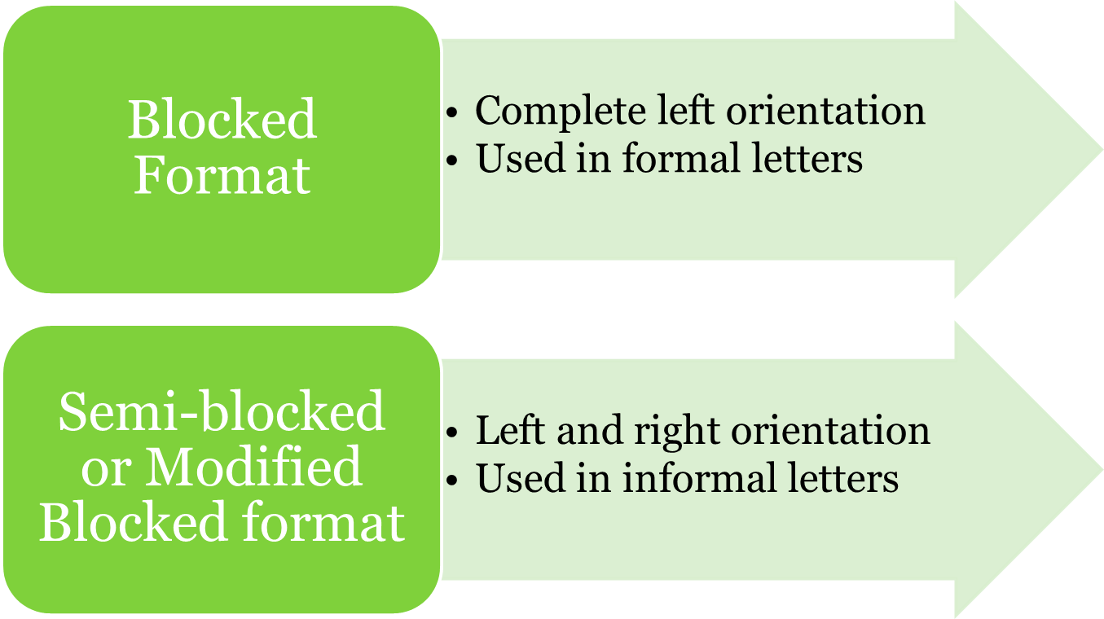

Slide 64
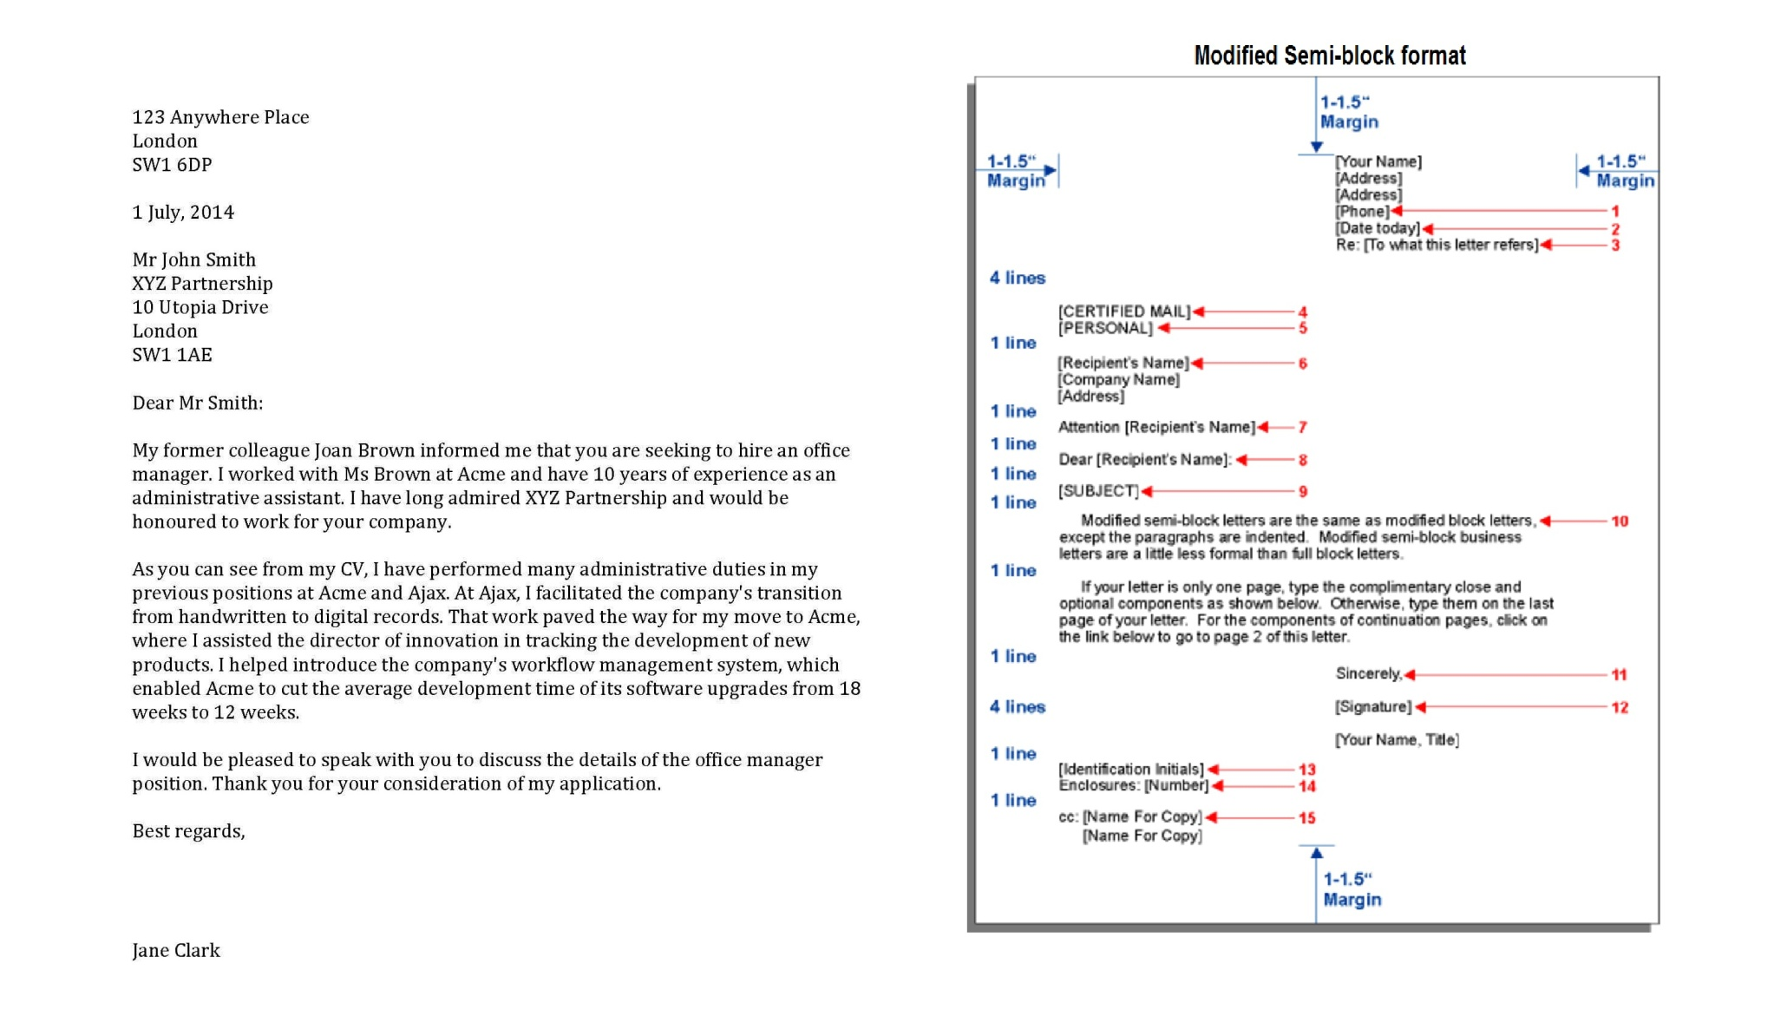

Slide 65
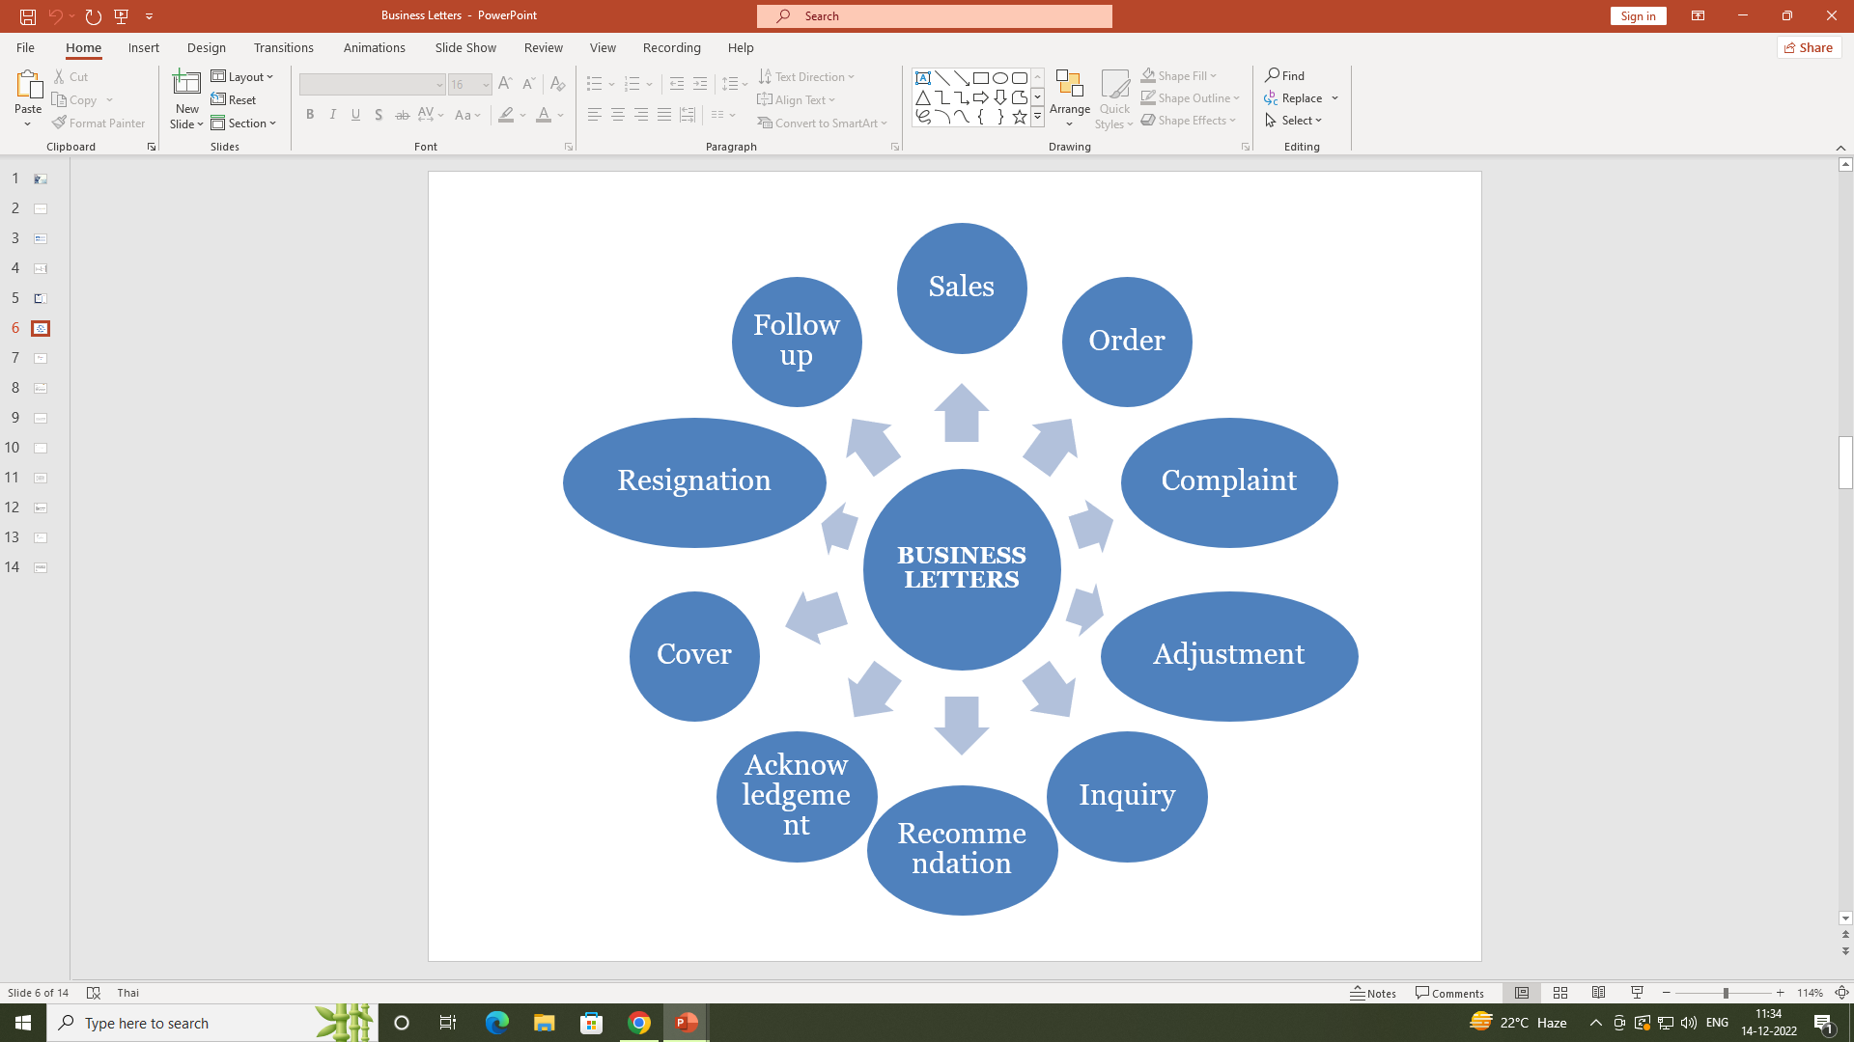

Slide 66
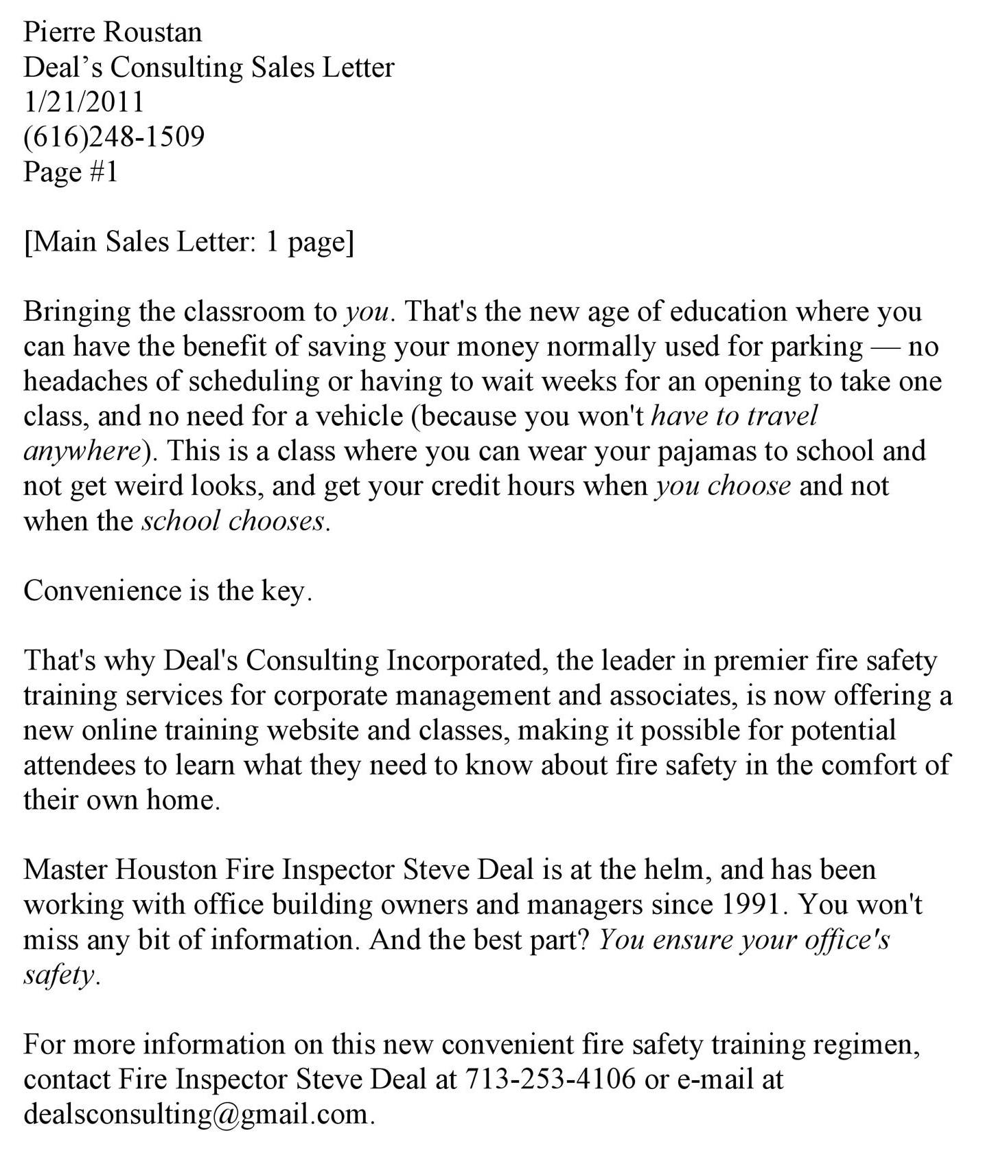

Slide 67

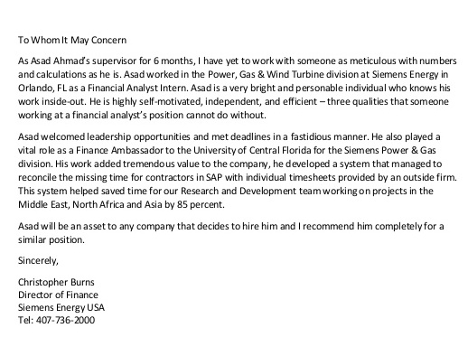

Slide 68

Key components of a job application letter:
Gaining attention
Building interest
Showing your worthiness
Motivating further action
These elements are formalized as : the opening, the body and the closing.

Slide 69

In Solicited Application letters an opening could be of any of the following types:
Mentioning source of information
Matching your credentials to employer’s need
Using references

Slide 70
In unsolicited application letters, the opening could be made by:
Using stimulating questions that highlight your strength
Using facts to show understanding of the employer’s business
Using startling statements

Slide 71

Describe achievements: qualification; professional training received, desired experience, refresher or orientation course etc.
Highlight your strengths: mention your intuitive or learned skills, special traits and positive qualities
Describe capabilities: capabilities in the interest of the employer, emphasis on matching qualification and training.

Slide 72

Refer to the re´sume´
Restate interest and reinforce your suitability
Express eagerness to meet the employer directly or ask for an interview
Include contact information and indicate about your availability

Slide 73

Give a professional look to your letter (1- 1.5 inch margin and adequate spacing between lines and paragraphs, good font)
Use positive tone: show confidence, genuine interest, specific details, be factual and objective, be organized and consistent

Slide 74


Slide 75

Correspondence that stays within a company is called MEMORANDUMS

Slide 76

TO
FROM
DATE
SUBJECT

Slide 77

Memos are informal, no titles
No salutation or closing
Use block style
Triple space between subject and body
Same notations as letters
Type file name in footer (optional)

Slide 78

Use the organization letter head
Clearly state the date, time and venue of the
meeting
Specify the reason ( agenda) for the meeting
Mention the name and designation of the issuing authority
†Mention the authorities to whom the copies are sent as Cc at the right/left bottom

Slide 79
Narmadha Rubber Industries Ltd
27, Palace Road, Noida,
New Delhi – 110 098
20 June 2018
NOTICE
The fourth meeting of the Board of Directors of the company will be held at the registered office of the company at 36, Motilal Street, Shimla at 5.00 p.m. on Monday, 12 July 2012.
The agenda is enclosed.
S. R. Raghavan (The Secretary)
Cc:The Chairman
Members of Board of Director

Slide 80

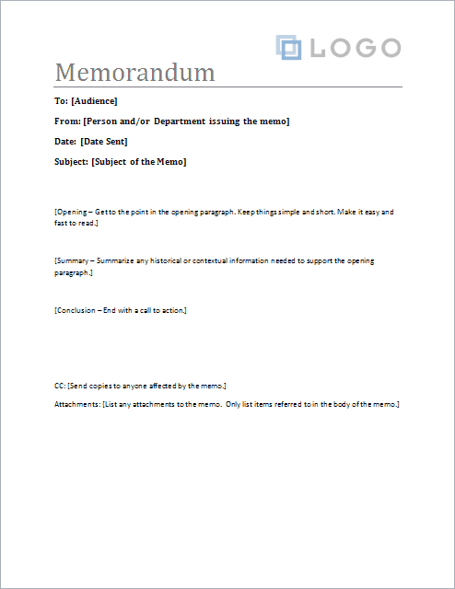

Slide 81

A listing of what is to take place during the meeting.

Slide 82

short notes taken to provide a record of a conference or a meeting
permanent and formal record of what happened
summary of discussion and action items

Slide 83

key points of discussions
actions to be taken
assignments given
deadlines

Slide 84
Include:
  Name of committee
  Date of meeting
  Time and place
  Name of person leading meeting
  List of names of people attending
  Time and place of next meeting

Slide 85
